Slide 1
Computer Modeling and Simulation
Lectures 25-27

Slide 2
Definition of Monte Carlo Simulation
Monte Carlo Simulation is this concept of repeated random samples of model input variables over many simulation runs .
When setting up a Monte Carlo simulation or employing the Monte Carlo Method, one follows a four - step process.
Step 1 Define a distribution of possible inputs for each input random variable.
Step 2 Generate inputs randomly from those distributions.
Step 3 Perform a deterministic computation using that set of inputs.
Step 4 Aggregate the results of the individual computations into the final result.

Slide 3
Step 1:
Step 1 Define a distribution of possible inputs for each input random variable.
Random variable is a variable whose values depend on outcomes of a random phenomenon.
For example: The outcome of a coin toss is a random variable with possible values of Head or Tail.
The distribution of these random numbers is a description of the portion of times each possible outcome or each possible range of outcomes occurs on the average over a great many trials.
Different distributions:
Uniform distribution Suppose a specified range is partitioned into intervals of the same length. With a uniform distribution, the generator is just as likely to return a value in any of the intervals.
Normal distribution
Exponential Distribution
Triangular Distribution etc.

Slide 4
Pseudorandom Numbers
Pseudorandom numbers are generated by computers.
They are not truly random, because when a computer is functioning correctly, nothing it does is random.
Computers

Slide 5
Applications of Pseudorandom Numbers
Pseudorandom numbers are essential to many computer applications, such as games and security. In games, random numbers provide unpredictable elements the player can respond to, such as dodging a random bullet or drawing a card from the top of a deck.
In computer security, pseudorandomness is important in encryption algorithms, which create codes that must not be predicted or guessed.

Slide 6
Pseudorandom number generator
A pseudorandom number generator, or PRNG, is any program, or function, which uses math to simulate randomness. It may also be called a DRNG (digital random number generator) or DRBG (deterministic random bit generator).
The math can sometimes be complex, but in general, using a PRNG requires only two steps:
Provide the PRNG with an arbitrary seed.
Ask for the next random number.
The seed value is a "starting point" for creating random numbers. The seed value is used when computing the numbers.
If the seed value changes, the generated numbers also change, and a single seed value always produce the same numbers. For this reason, the numbers aren't really random, because true randomness could never be re-created.
The current time is often used as a unique seed value. For instance, if it's March 5, 2018, at 5:03 P.M. and 7.01324 seconds UTC, that can be expressed as an integer. That precise time never occur again, so a PRNG with that seed should produce a unique set of random numbers.

Slide 7
Linear Congruential Method – A PRNG
In 1949, D. J. Lehmer presented one of the best techniques for generating uniformly distributed pseudorandom numbers, the linear congruential method.
One simple linear congruential random number generator that generates values between 0 and 10, inclusive, is as follows:
r₀ = 10
r_{n} = (7r_{n–1} + 1) mod 11, for n > 0
The initial value in the sequence of random numbers, r₀ = 10, is the seed. The mod function returns the remainder.
Thus, substituting r₀ = 10 on the right-hand side of the second line of the definition, the generating function, we calculate r₁ = (7 · 10 + 1) mod 11 = 5.
After we calculate one “random number,” to evaluate the next, we substitute that value into the expression on the right-hand side. Consequently, the next random number is r₂ = (7 · 5 +1) mod 11 = 3

Slide 8
Linear Congruential Method
The general form for the linear congruential method to generate pseudorandom integers from 0 up to, but not including, modulus is as follows:
r₀ = seed
r_{n} = (multiplier r_{n–1} + increment) mod modulus, for n > 0
where seed, modulus, and multiplier are positive integers and increment is a nonnegative

Slide 9
Random Floating-point Number generation
If we desire floating-point numbers between 0 and 1, we divide each number in the sequence by the modulus.
For this computation, the smallest possible pseudorandom floating-point number is 0.0 and the largest is (modulus – 1)/modulus. Thus, floating-point numbers that we generate by dividing by the modulus are in the interval [0.0, 1.0), or the interval between

Slide 10
Possible values for multiplier and modulus
Much research has been done to discover choices for multiplier and modulus that give the largest possible sequence that appears random.
For built-in random number generators, modulus is often the largest integer a computer can store, such as 2³¹ – 1 = 2,147,483,647 on some machines. For this modulus, a multiplier of 16,807 and an increment of 0 produce a sequence of 2³¹

Slide 11
Different Ranges of Random Numbers
The linear congruential method generated a random integer from 0 up to the modulus, where by up to we mean not including the modulus.
We can obtain a floating-point counterpart with value from 0.0 up to 1.0 by dividing by the modulus.
We can obtain uniformly distributed integer or real random numbers in any range.
Suppose that rand is a uniformly distributed random floating point number from 0.0 up to 1.0. Suppose, however, that we need a random floating point number from 0.0 up to 5.0. Because the length of this interval is 5.0, we multiply rand

Slide 12
Random numbers within any range
Mathematically, we have the following:
0.0 ≤ rand < 1.0
Thus, multiplying by 5.0 throughout, we obtain the correct interval, as shown:
0.0 ≤ 5.0 rand < 5.0
If the lower bound of the range is different from 0, we add that bound. For example, if we need a random floating-point number from 2.0 up to 7.0, we multiply by the length of the interval, 7.0 – 2.0 = 5.0, to expand the range. Then, we add the lower bound, 2.0, to shift, or translate, the result so that the following inequalities hold:
2.0 ≤ (7.0 – 2.0) rand + 2.0 < 7.0
or
2.0 ≤ 5.0 rand

Slide 13
Specifying Random Floating-Point Numbers in Other Ranges
If rand is a random floating-point number such that 0.0 ≤ rand < 1.0, then (max – min)rand + min is a random floating-point number from min up to max that satisfies the following inequality:
min ≤ (max – min) rand + min < max

Slide 14
Random Integer numbers upto the modulus
Frequently, we need a more-restricted range of random integers than from 0 up to modulus.
For example, a simulation might require random integer temperatures between 0 and 99, inclusive.
One method of restricting the range is to multiply a floating-point random number between 0.0 and 1.0 by 100 (the number of integers from 0 through 99, or 99 + 1) and then return the integer part (the number before the decimal point). For example, suppose rand is 0.692871. Multiplying by 100, we obtain 100 · 0.692871 = 69.2871. Truncating, we obtain an integer (69) between 0 and

Slide 15
Random Integer numbers with lower bound other than 0
Sometimes we want the range of random integers to have a lower bound other than 0, for example, from 100 to 500, inclusive. Because we include 100 and 500 as options, the number of integers from 100 to 500 is one more than the difference in these values, (500 – 100 + 1) = 401.
As with the last example, we multiply this value by rand to expand the range. Then, we add the lower bound, 100, to the product to translate the range to start at 100 as follows:
100.0 ≤ 401rand

Slide 16
Random Integer numbers upto the modulus with lower bound other than 0
Finally, we take the integer part of the result, which we write here as applying a function INT.
100 ≤ INT(401rand + 100) < 501
or
100 ≤ INT(401rand + 100) ≤ 500
Because the floating-point numbers (401rand + 100) are less than 501.0, after truncation, the

Slide 17
Specifying Random Integers in Other Ranges
If rand is a random floating-point number such that 0.0 ≤ rand < 1.0, then INT((max – min + 1)rand + min) is a random integer from min to max, inclusive, that satisfies the following inequality:
min ≤ INT( (max – min + 1)·rand + min) ≤ max

Slide 18
Discrete Distributions with varying probability of events
Frequently, however, the discrete choices do not carry equal probabilities.
For example, in an initial 3D grid, suppose only 15% of the grid sites, or cells, contain pollen grains. Thus, a probPollen = 15% = 0.15 chance exists for a cell to contain a grain.
If the location is to contain a pollen grain, we make the cell’s value equal to POLLEN = 1; otherwise, the cell’s value becomes EMPTY = 0.
To initialize a grid for a simulation, we must designate for each cell if the location contains pollen or not.
For each cell, we need to generate a uniformly distributed random floating-point number from 0.0 up to 1.0. On the average, 15% of the time this random number is less than 0.15, while 85% of the time the number is greater than or equal to 0.15.
Thus, to initialize the cell, if the random number is less than 0.15, we make the cell’s value POLLEN; otherwise, we assign EMPTY to the cell’s value.

Slide 19
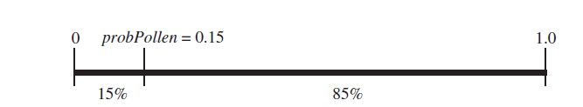
Discrete Distributions with varying probability of events
Using the probabilities and cell values, employ the following logic is employed to initialize each cell in the grid:
if a random number is less than probPollen (i.e., pollen grain at site)
set the cell’s value to POLLEN
else (i.e., no pollen grain at site)
set the cell’s value to EMPTY
Fig: 15% of floating-point values between 0 and 1 are less than probPollen = 0.15

Slide 20
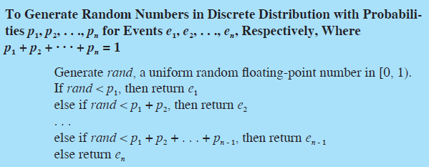
Discrete Simulations with varying probabilities

Slide 21
Step 1:
If this distribution is known or sufficient data exist to derive it, then this step is straightforward.
However, if the behavior of an input variable is not well understood, then the modeler might have to estimate this distribution based on empirical observation or subject matter expertise.
The modeler may also use a uniform distribution if he or she is lacking any specific knowledge of the variable ’ s characteristics.
When additional information is gathered to define the variable, then the uniform distribution can be replaced.

Slide 22
Step 2:
Step 2 Generate inputs randomly from those distributions.
Step 2 requires randomly sampling each input variable ’ s distribution many times to develop a vector of inputs for each variable.
Suppose we have two input random variables X and Z.
After sampling n times, we have X = (x₁, x₂,… , x_{n}) and Z = (z₁, z₂, … , z_{n}).
Elements from these vectors are then sequentially chosen as inputs to the function defining the model.
The question of how large n should be is an important one because the number of samples determines the power of the output test statistic.
As the number of samples increases, the standard deviation of the test statistic decreases.
In other words, there is less variance in the output with larger sample sizes.
However, the increase in power is not linear with the number of samples so there is a point when more sampling provides little improvement.

Slide 23
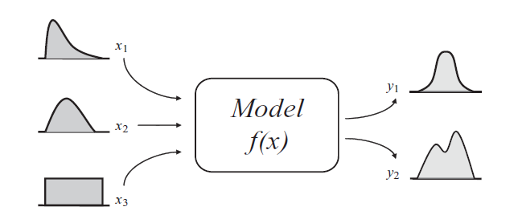
Basic Monte Carlo Model

Slide 24
Steps 3 and 4
Step 3 is straightforward. It involves sequentially choosing elements from the randomly generated input vectors and computing the value of the output variable or variables until all n outputs are generated for each output variable.
Step 4 involves aggregating all these outputs. Suppose we have one output variable Y. Then we would have as a result of step 4 an output vector Y = (y1,y2, … , yn).
We can then perform a variety of statistical tests on Y to analyze this output.

